Slide 1
Chapter 8
Bivariate Correlational Research

Slide 2
Agenda
Bivariate Correlations
Interrogating the Validity of Bivariate Correlations
Next time on PSY 270…

Slide 3
Bivariate Correlations

Slide 4
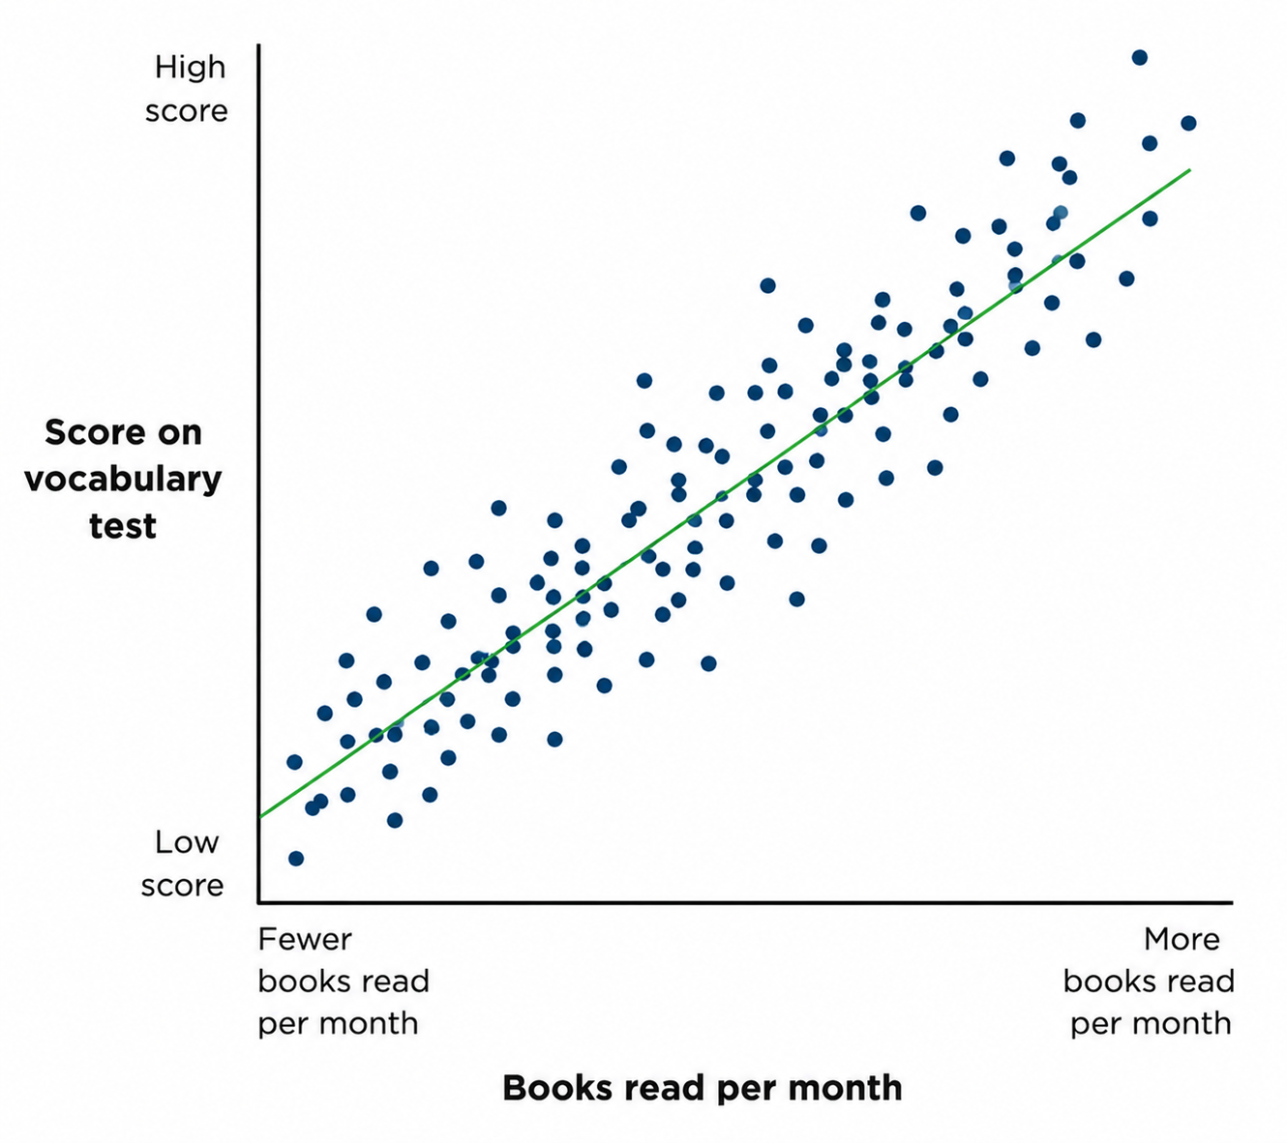
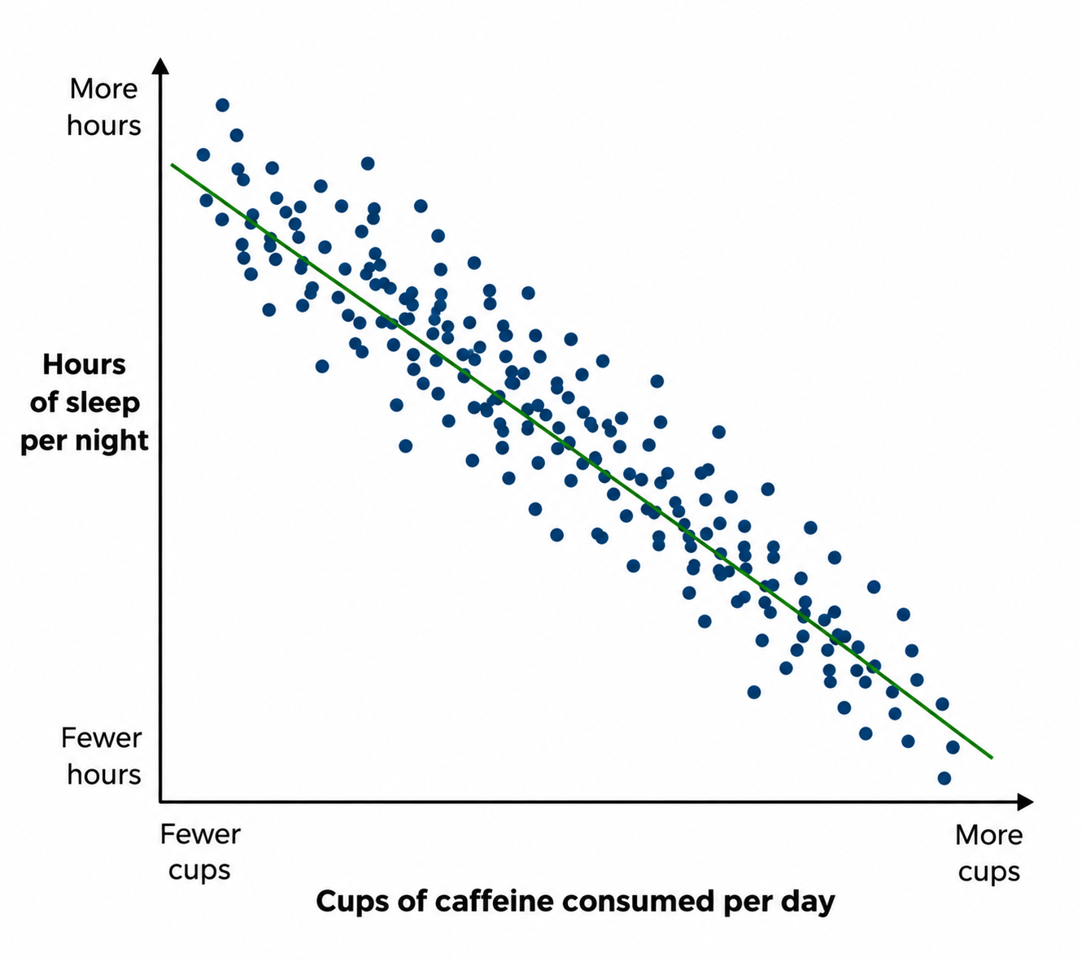
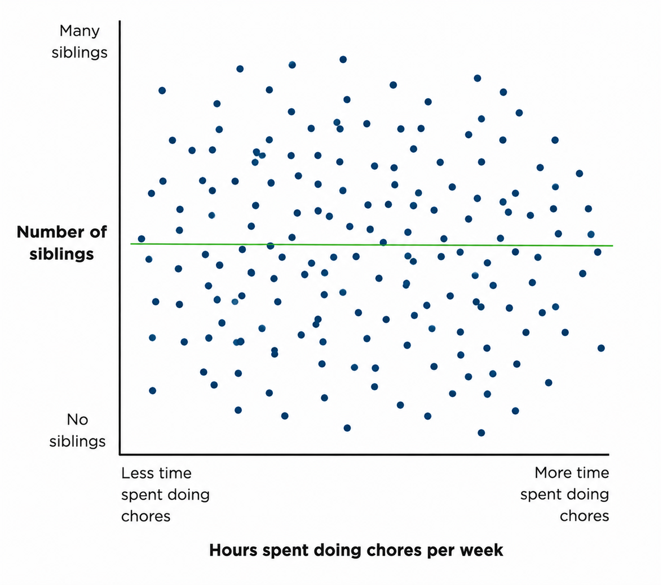
Last Time(ish) on PSY 270…
Association claim – a claim that one level of a variable is likely to be associated with a particular level of another variable
  Can be positive, negative, or no association (the direction of the correlation)
  Can vary in strength (the absolute value of the correlation)

Slide 5
So…
When we say “bivariate correlational research” what types of claims are we looking at?

Slide 6
Bivariate Correlations
Bivariate correlations (aka, bivariate associations) – associations that involve exactly two variables
Most commonly, we are comparing two continuous (quantitative) variables
  Ex: hours of sleep and grade on exam
Sometimes, we will look at one continuous and one categorical variable
  Ex: quality of sleep (good vs bad) and grade on exam

Slide 7
Comparing Two Continuous Variables
Association claims between 2 continuous variables are most often assessed through Pearson’s correlations
Reminder about Pearson’s r
  The sign (+/-) tells you the direction of the relationship (positive, negative, or zero)
  The absolute value tells you the strength of the relationship. The general rule of thumb:
    0.1 - 0.29= small (weak) correlation
    0.3 – 0.49 = medium (moderate) correlation
    Greater than 0.5 = large (strong) correlation
If one of your variables is ordinal, you would use Spearman’s correlation instead

Slide 8
Comparing 1 Categorical & 1 Continuous Variable
If you have one continuous variable and one categorical variable, you can still calculate a meaningful correlation, as long as your categorical variable is binary (only 2 categories). To make the math work, you “code” 1 category a value of “0” and 1 category a value of “1”
  Technically, you could have more than 2 categories, but the meaningfulness of the correlation gets hazy
Note: In most student research with 1 categorical and 1 continuous variable, we would conduct a t-test instead (experimental research rather than correlational research)

Slide 9
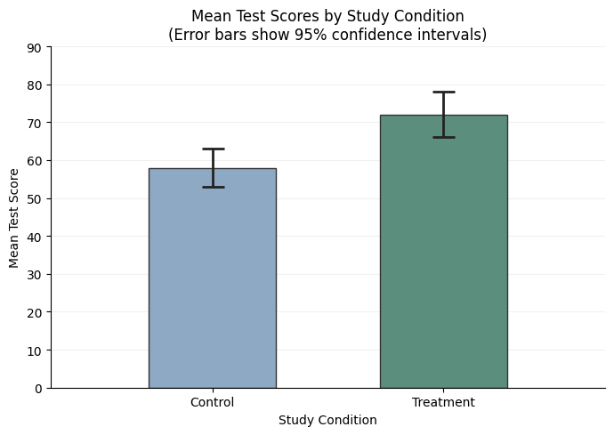
Comparing 1 Categorical & 1 Continuous Variable
When presenting associations with 1 categorical variable, we would typically utilize a bar graph
With the bar graph, you can
see the mean (arithmetic average)
and the margin of error (wiggle
room around the mean)

Slide 10
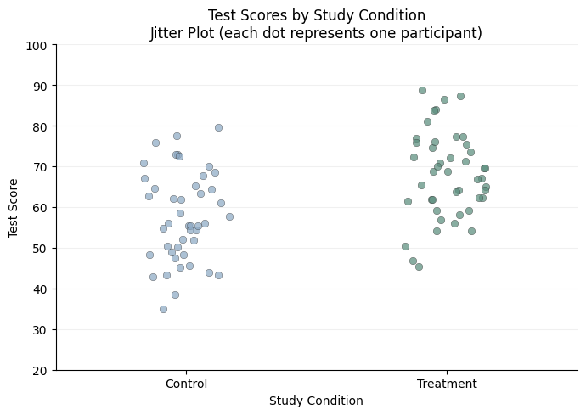
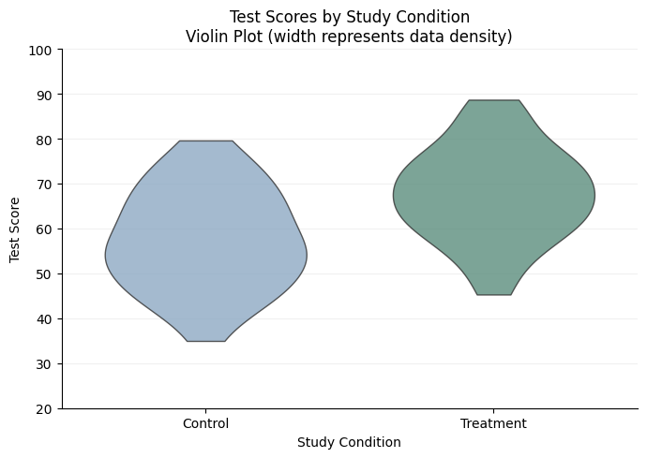
Comparing 1 Categorical & 1 Continuous Variable
You could also use variations of scatterplots, such as jitter plots and violin plots
  These tell you more about the distribution, but the comparison between categories is less clear

Slide 11
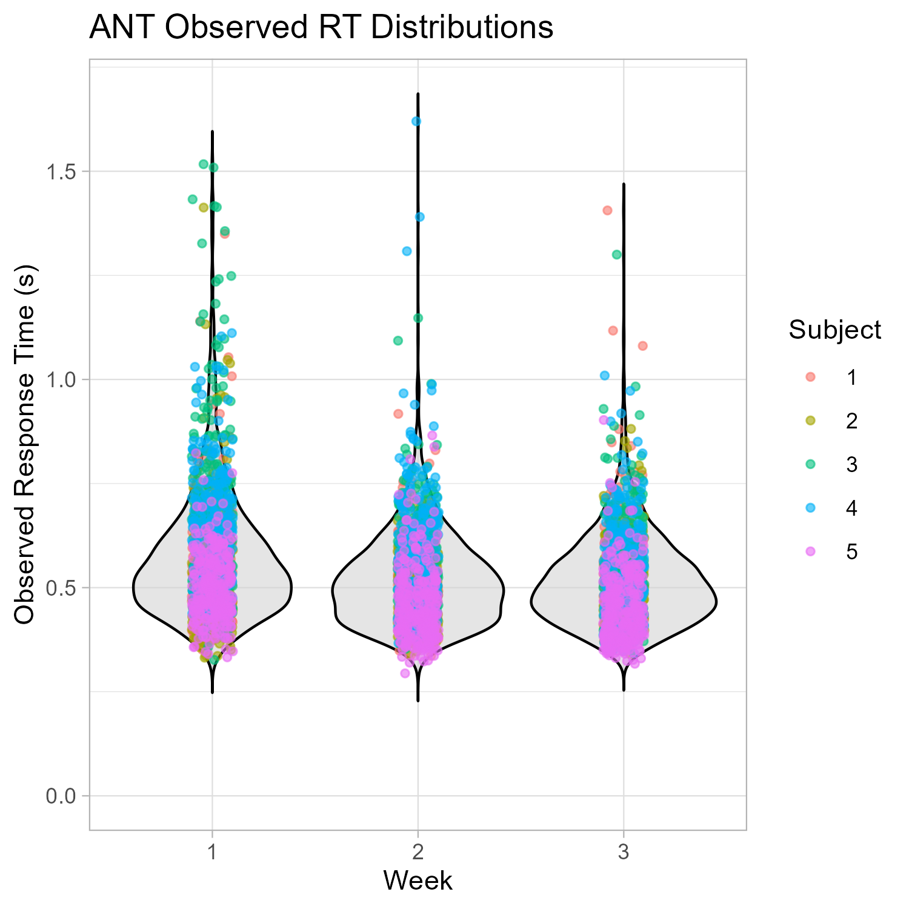
A Quick Note on Reading Jitter/ Violin Plots
The distribution of points tells you which values are most common
For example, I looked at response times on an attention task for my dissertation
During the first week (the week before finals), there were a lot more points where people took over 1 second to respond to a trial
By the week after finals, a much larger proportion were completing the trial in about 0.5 seconds

Slide 12
But wait…
What if we wanted to “upgrade” our claim from association to causal?

Slide 13
Question for the class…
What are the 3 requirements for causal claims?

Slide 14
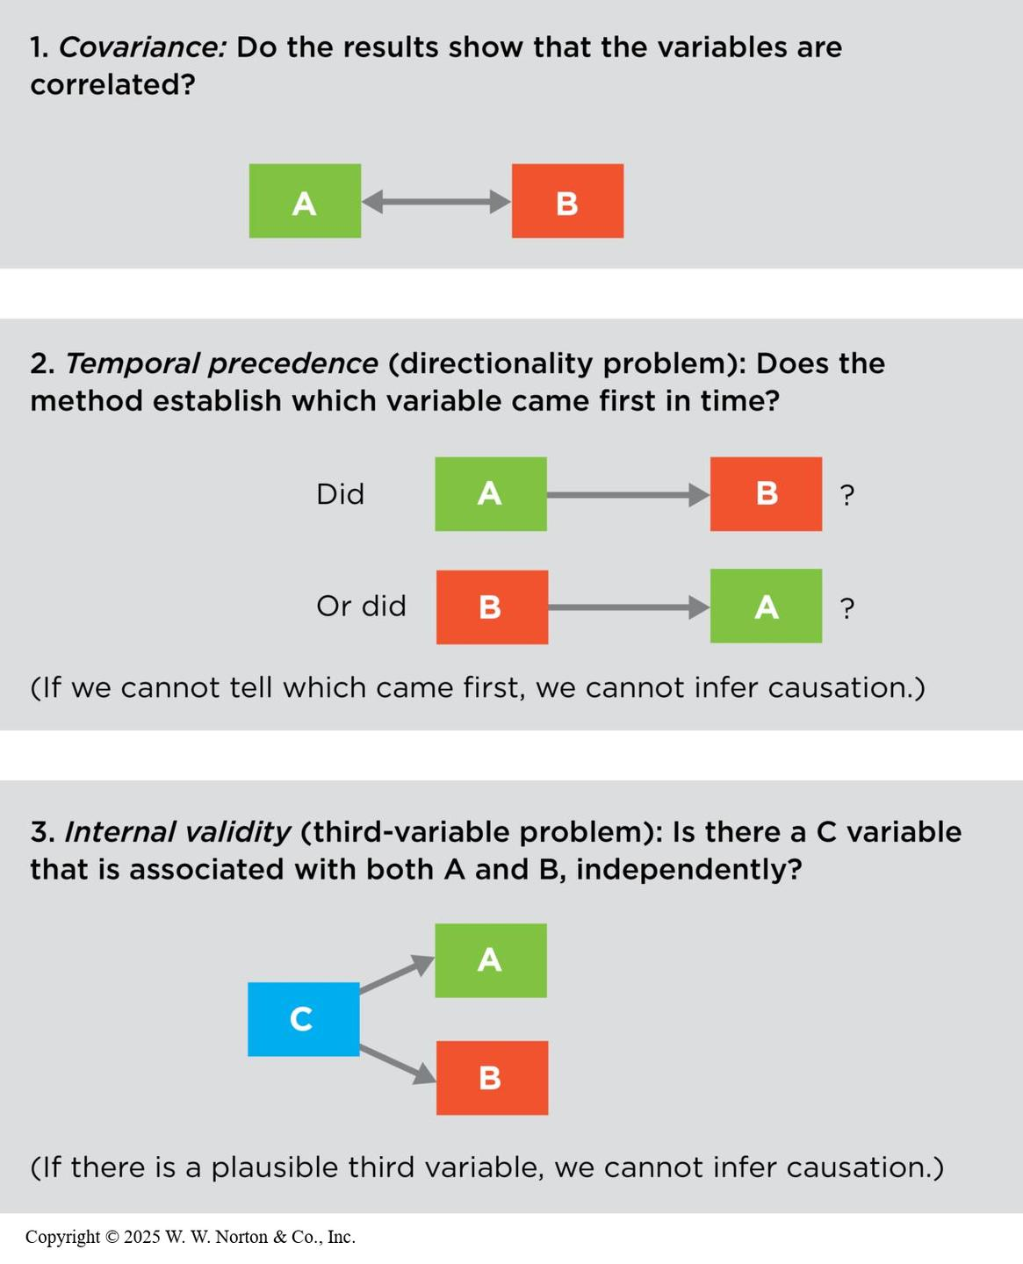
Using Correlations to Look Into Causal Claims
You COULD use correlations with causal claims as well, but you HAVE to establish that the three requirements are met
  You should use multivariate correlations instead of bivariate
Experimental designs make it easier to establish causation, which is why it is much more common to evaluate causal claims with experimental research instead of correlational research

Slide 15
Interrogating the Validity of Bivariate Correlations

Slide 16
Interrogating Our Correlations
Construct validity: How well was each variable measured?
01
Statistical validity: How well do the data support the conclusion?
02
Internal validity: Can we make a causal inference from an association?
03
External validity: To whom can the association be generalized?
04

Slide 17
Interrogating the Construct Validity
For both variables, you will ask things like…
  How well was the variable measured?
  Does the measure have good reliability?
  Is it measuring what it’s intended to measure? (ex: criterion validity)
  What is the evidence for its face validity?
  What is the discriminant validity? Convergent validity?

Slide 18
Interrogating the Statistical Validity
When interrogating the statistical validity, you will ask things like…
  How strong is the relationship?
  How precise is the estimate?
  Could outliers be affecting the association?
  If you repeated the experiment with a similar group, would the results replicate?
  Is there restriction of range?
  Is the association curvilinear?

Slide 19
How Strong is the Relationship?
Look at the scatterplot and the Pearson’s correlation
Look at the effect size (common option: Cohen’s d)
  Larger effect size = larger impact of one variable on the other
  While the goal is to have a larger effect, small effects can still be important, especially when combined across multiple observations (for example: cost of fuel)

Slide 20
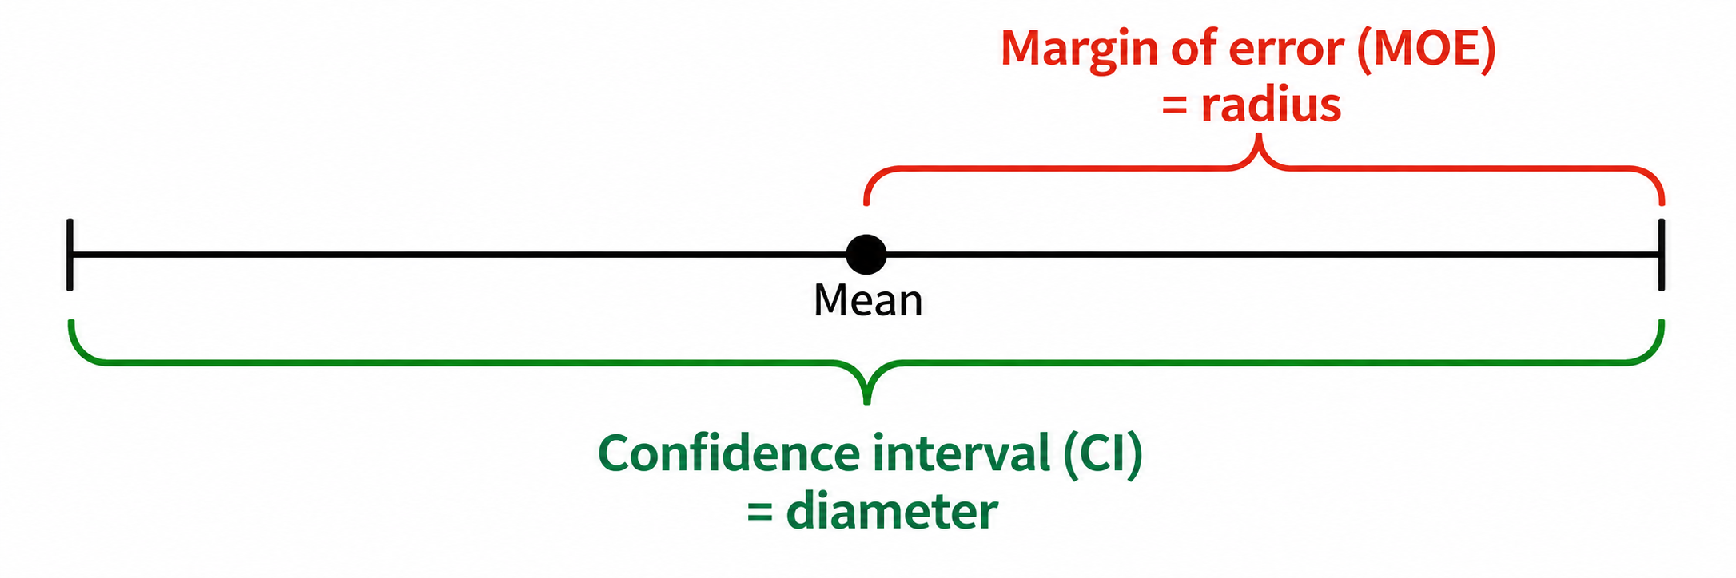
How Precise is the Estimate?
Margin of error – the amount of wiggle room to either side of the point estimate
Confidence interval – the range of values most likely to contain the true population value
If the mean is the point at the center of the circle, the margin of error is the radius, and the confidence interval is the diameter
Confidence Interval = Point Estimate ± Margin of Error

Slide 21
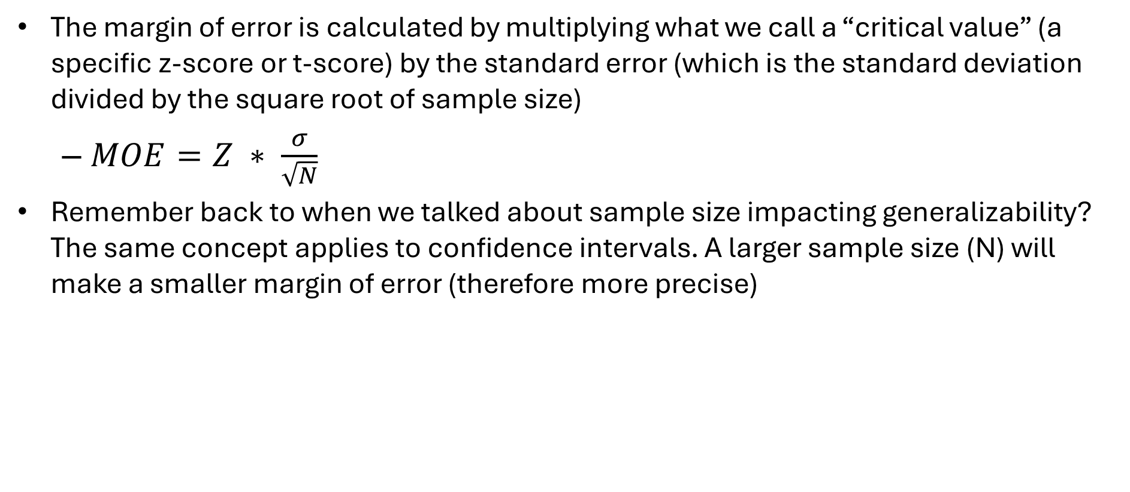
How Precise is the Estimate?
The margin of error is calculated by multiplying what we call a “critical value” (a specific z-score or t-score) by the standard error (which is the standard deviation divided by the square root of sample size)
  $MOE=Z ∗ \frac{σ}{\sqrt{N}}$
Remember back to when we talked about sample size impacting generalizability? The same concept applies to confidence intervals. A larger sample size (N) will make a smaller margin of error (therefore more precise)

Slide 22
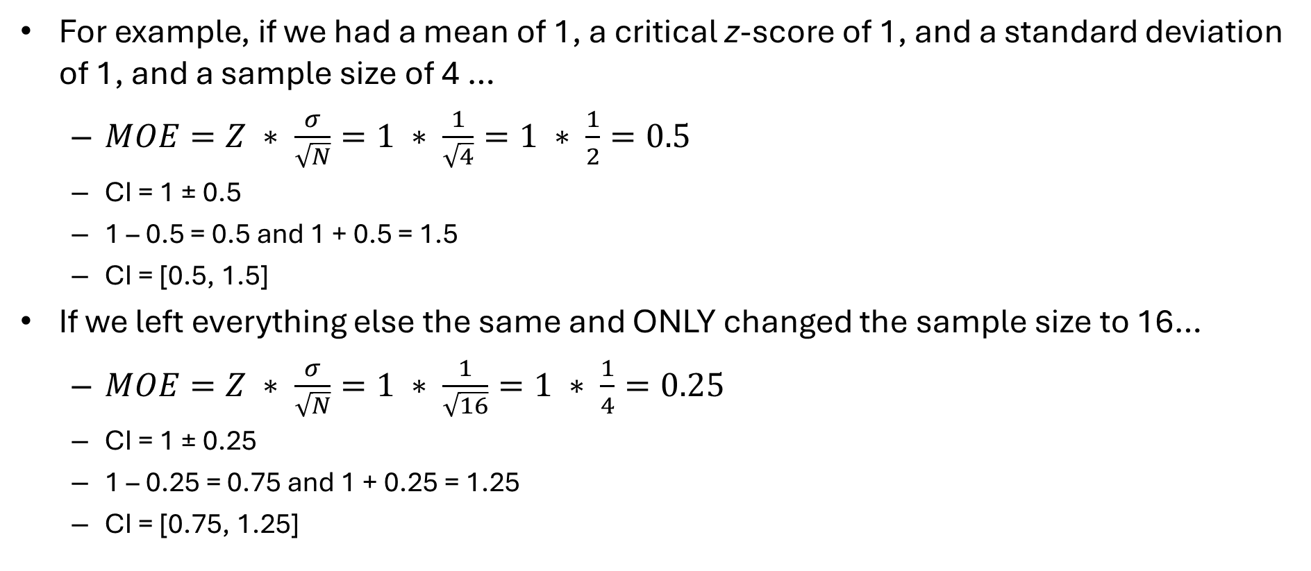
How Precise is the Estimate?
For example, if we had a mean of 1, a critical z-score of 1, and a standard deviation of 1, and a sample size of 4 …
  $MOE=Z ∗ \frac{σ}{\sqrt{N}}=1 ∗ \frac{1}{\sqrt{4}}=1 ∗ \frac{1}{2}=0.5$
  CI = 1 ± 0.5
  1 – 0.5 = 0.5 and 1 + 0.5 = 1.5
  CI = [0.5, 1.5]
If we left everything else the same and ONLY changed the sample size to 16…
  $MOE=Z ∗ \frac{σ}{\sqrt{N}}=1 ∗ \frac{1}{\sqrt{16}}=1 ∗ \frac{1}{4}=0.25$
  CI = 1 ± 0.25
  1 – 0.25 = 0.75 and 1 + 0.25 = 1.25
  CI = [0.75, 1.25]

Slide 23
How Precise is the Estimate?
When looking at the confidence intervals for correlations, there are a couple things we will look at:
  How narrow is the margin of error?
  Does the confidence interval contain zero? (ex: CI = [-0.3, 0.4]
    If it does contain zero, that means we can’t tell if there is a positive, negative, or no relationship (so the relationship is not precise enough to determine a real association)

Slide 24
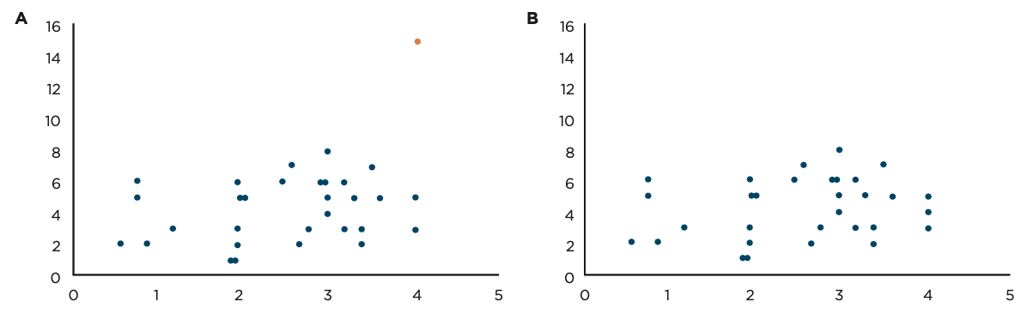
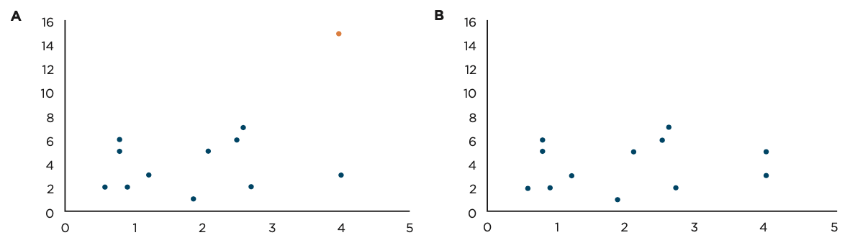
Could Outliers Be Affecting the Association?
Outliers have the power to move the correlation, ESPECIALLY if the sample size is small

Slide 25
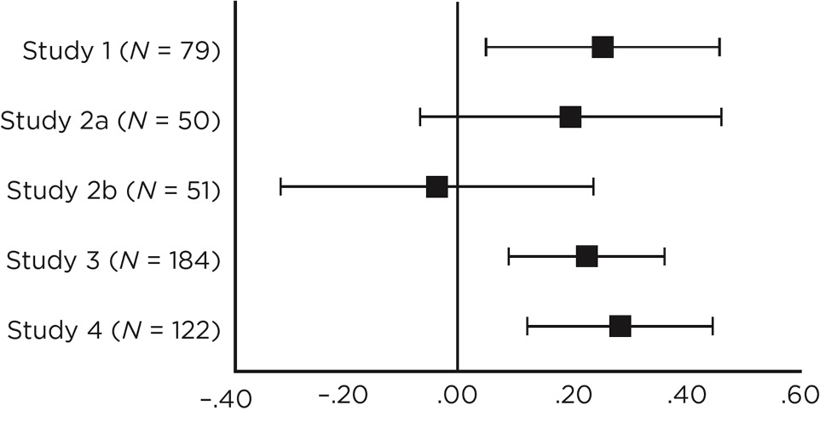
Has It Been Replicated?
It is common to conduct multiple smaller studies, especially when developing something new to the field
Ex: Using Scheuler’s Super Savy Stats Scale to measure statistical knowledge across multiple semesters, to see if it is associated with class averages

Slide 26
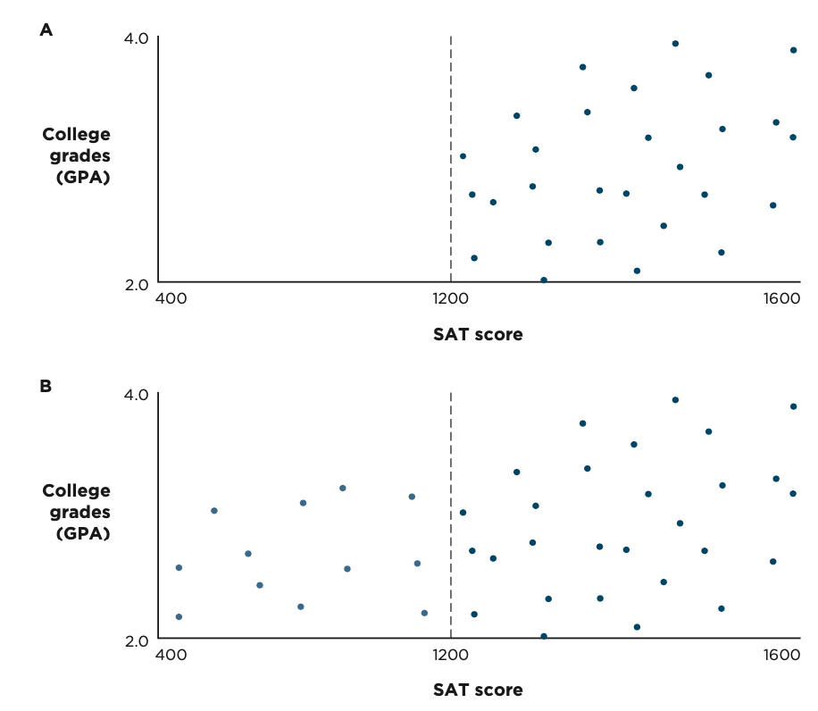
Is There Restriction of Range?
Could we see different results if we expanded our range?
For example, consider SAT scores and college grades. If a university won’t accept anyone with an SAT below 1200, it could force the correlation to look different

Slide 27
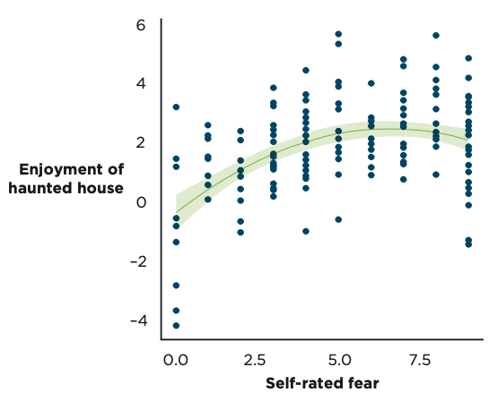
Is the Association Curvilinear?
If we only look at Pearson’s r, we might mistakenly assume that there is no relationship, when the scatterplot would show that there is a relationship, it’s just not linear

Slide 28
Interrogating the Internal Validity
Think back to earlier in this lecture…
Why might it be difficult to evaluate internal validity with bivariate correlations?
Note: this is how we end up with spurious correlations
  Note: For fun, see: https://www.tylervigen.com/spurious-correlations

Slide 29
Interrogating the External Validity?
Pop quiz! Random ________________ is important for external validity
How much we care about the external validity for correlational research depends on the context
Just like third variables could impact internal validity, they could also impact external validity
  We will get into these mediators and moderators more in the next chapter

